Slide 1
ML/AI Introduction + Hands-on Exercise
Umair Mohammad, Florida International University
OpenCI Award: OCI 21-38296

Slide 2
Scope
AI, ML and DL
How useful is ML/AI and why now?
Regression
Classical ML
Tools and Technologies
Deep Learning
Generational Age

Slide 3
Scope
AI, ML and DL
How useful is ML/AI and why now?
Regression
Classical ML
Deep Learning
Generational Age

Slide 4
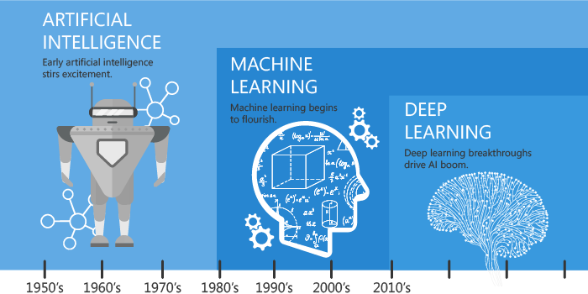
AI vs ML vs DL
Notes:
https://www.analyticsvidhya.com/blog/2021/07/ai-vs-ml-vs-dl-lets-understand-the-difference/

Slide 5
Types of ML Tasks
Prediction/Forecasting
Classification/Recognition
Object Detection
Image Segmentation
Recommendation
Speech-to-text, etc.
Grouping
PDF estimation
Dimensionality Reduction
Similarity Matching
Link Prediction
Anomaly Detection
Querying
Synthesis

Slide 6
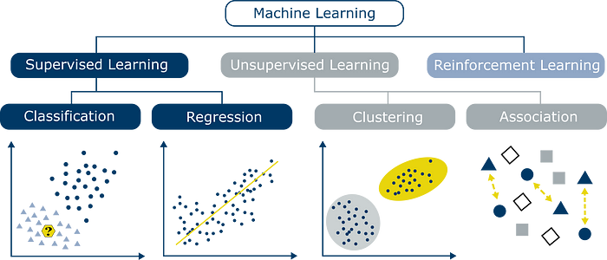
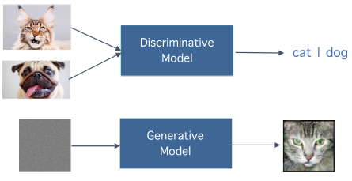
Learning types
Supervised Learning
Unsupervised Learning
Reinforcement Learning
Semi/Self-Supervised
{In/Con/Trans}-Duction
Summary:
Classification Phase
Generative Phase
Notes:
Top image: https://towardsdatascience.com/7-of-the-most-commonly-used-regression-algorithms-and-how-to-choose-the-right-one-fc3c8890f9e3
Bottom Image: https://www.researchgate.net/publication/341478640_An_Overview_of_Privacy_in_Machine_Learning
Useful Video: https://www.youtube.com/watch?v=XJVdnJiyCho

Slide 7
Scope
AI, ML and DL
How useful is ML/AI and why now?
Regression
Classical ML
Deep Learning
Generational Age

Slide 8
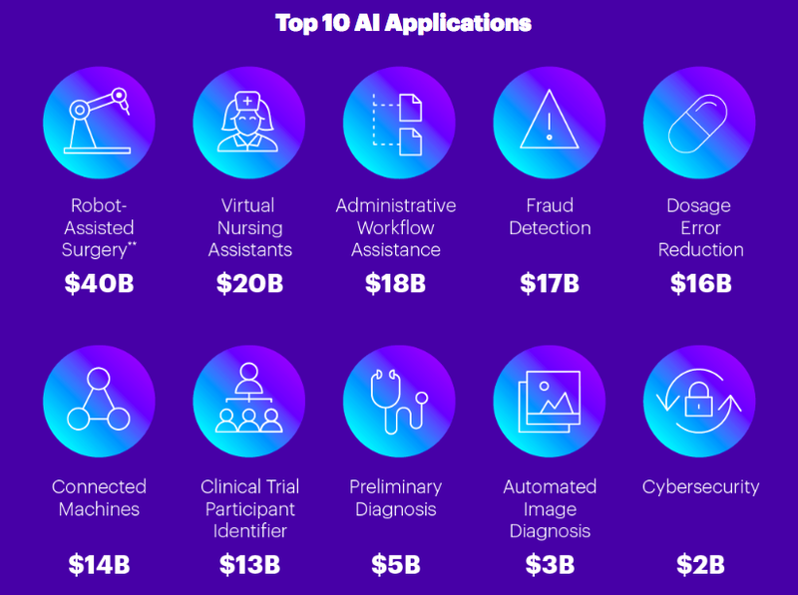
Applications
Autonomous Cars
Unmanned Aerial Vehicles (UAVs)
Medical Diagnostics/Detection
Arrythmia, Seizure, Cancer, etc.
Amazon/Social Media Recommender Systems
Content Generation (Ethical?)
Bank/Credit Card Fraud Detection
LLM’s e.g. ChatGPT and Bard
AI-Whisperer’s?
Notes:
https://community.singularitynet.io/t/top-10-ai-applications-in-healthcare-that-can-save-150-billion-annually-according-to-accenture/746

Slide 9
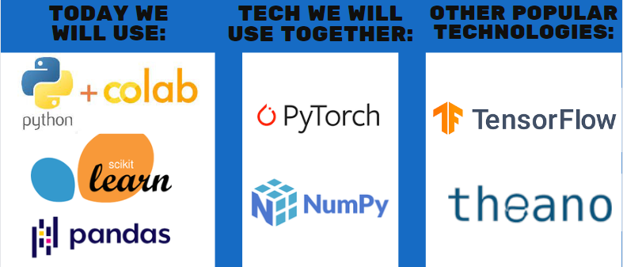
Why Now? Tools and Tech
AI-Winter 1960’s
Algorithmic Limits
Hardware Limits
Resurgence
21st century up-to 2010
New algorithms
Open-source models
New “Programming”
Applicable to any area!

Slide 10
Other tools and technologies
General-purpose Graphical Processing Units (GPGPUs)
Nvidia
High Performance Computing Clusters (HPC’s)
Expanse
Cloud Computing
Microsoft Azure, Amazon Web Services (AWS), Google Cloud, etc.
Open-source and reproducible models
Python-based libraries; Weights and Biases

Slide 11
Scope
AI, ML and DL
How useful is ML/AI and why now?
Regression
Classical ML
Deep Learning
Generational Age

Slide 12
Linear Regression
Predict/Forecast a scalar-valued target
Curve-Fitting simplest example
Equation of a straight line
Notes:
https://www.cs.toronto.edu/~rgrosse/courses/csc421_2019/slides/lec02.pdf

Slide 13
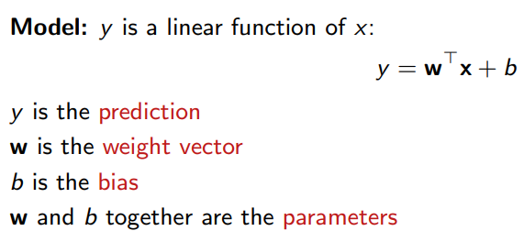
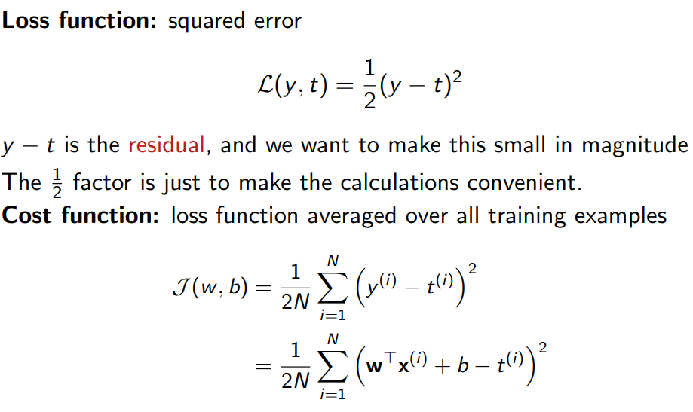
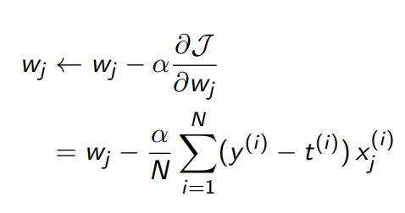
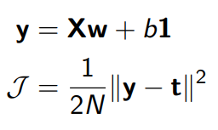
Gradient Descent
Notes:
https://www.cs.toronto.edu/~rgrosse/courses/csc421_2019/slides/lec02.pdf

Slide 14
Hands-on Activity

Slide 15
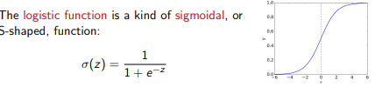
Logistic Regression
Similar to Linear regression
A sigmoid activation is used
Cross-entropy loss
Used for binary classification
Outputs are probabilities
Labels are discrete
Continuous needed to be differentiable
Notes:
https://www.cs.toronto.edu/~rgrosse/courses/csc421_2019/slides/lec02.pdf

Slide 16
Scope
AI, ML and DL
How useful is ML/AI and why now?
Regression
Classical ML
Deep Learning
Generational Age

Slide 17
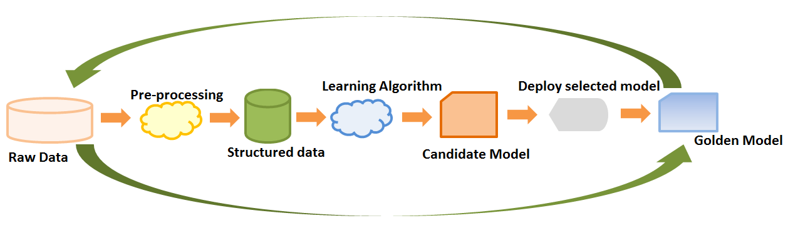
The ML Process
Should I?
Data Wrangling
Preprocessing/Visualization
Feature Extraction/Selection
Model Selection
Optimization
Evaluation and Improvement
Notes:
https://elearningindustry.com/machine-learning-process-and-scenarios

Slide 18
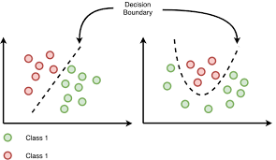
Linear Classification
Theory
Predict a discrete valued target
Linearly relate features
Methods
Logistic Regression
Naïve Bayes
Support Vector Machines
Single-Layer Perceptron's
Notes:
https://towardsdatascience.com/logistic-regression-and-decision-boundary-eab6e00c1e8

Slide 19
Hands-on Activity

Slide 20
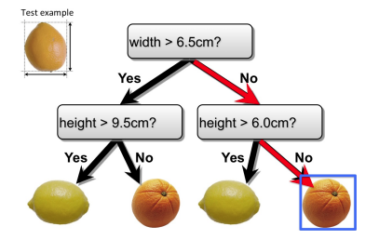
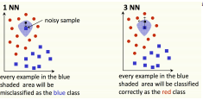
Other Algorithms
Decision Trees
Binary trees with nodes, leaf's, etc.
Idea 2
Random Forests
Bagging of decision trees
Decreases the variance, reduces over-fitting
K-nearest Neighbor
Euclidean distance with k neighbors
Majority Voting
Boosting and Bagging
Ensemble Classifiers
Notes:
https://www.cs.toronto.edu/~rgrosse/courses/csc311_f21/lectures/lec01.pdf https://www.cs.toronto.edu/~rgrosse/courses/csc311_f21/lectures/lec02.pdf

Slide 21
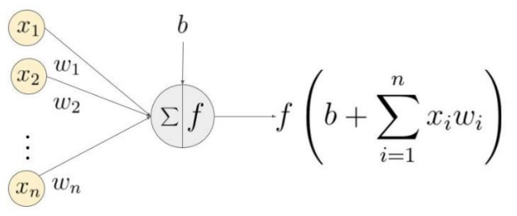
Neural Networks (NNs)
Multiple “hidden” layers
Build upon single-layer
Can do non-linear
Feedforward
Can approximate any function
Notes:
https://arxiv.org/ftp/arxiv/papers/2006/2006.11374.pdf

Slide 22
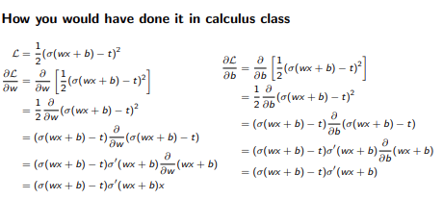
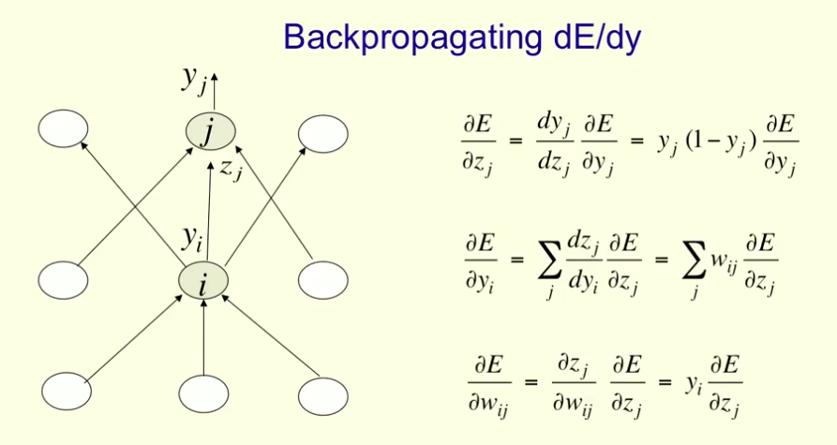
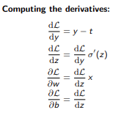
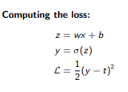
Backpropagation
Notes:
Derivations: https://www.cs.toronto.edu/~rgrosse/courses/csc421_2019/slides/lec04.pdf Backpropagation Image: https://stats.stackexchange.com/questions/267486/backpropagation-algorithm-in-neural-networks-nn-with-logistic-activation-funct

Slide 23
Scope
AI, ML and DL
How useful is ML/AI and why now?
Regression
Classical ML
Deep Learning
Generational Age

Slide 24
Deep NN’s
Multiple hidden layers
Complex Backpropagation using the chain-rule
Convolutional
Discrete convolution – a DSP concept
Element-wise multiplication, summing and aggregation
Very powerful tool – represents filtering – Edge Detection
Convolutional Neural Network (CNN)
Yann LeCunn and MNIST (The postal system started the AI revolution)

Slide 25
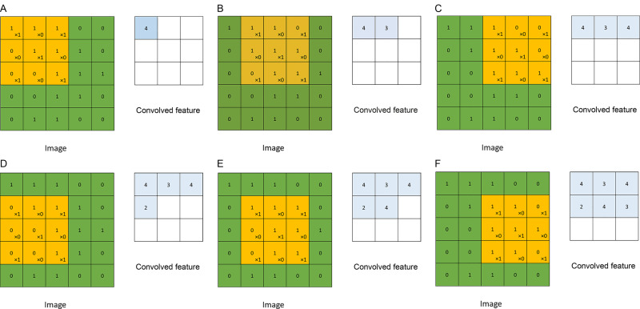
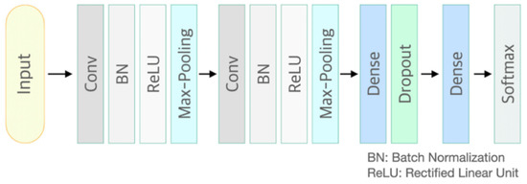
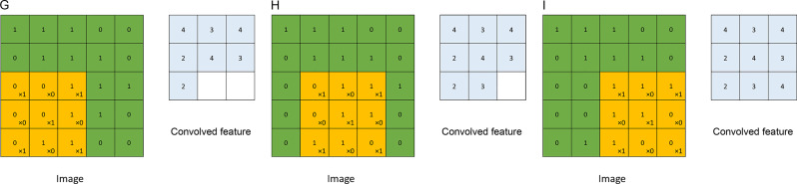
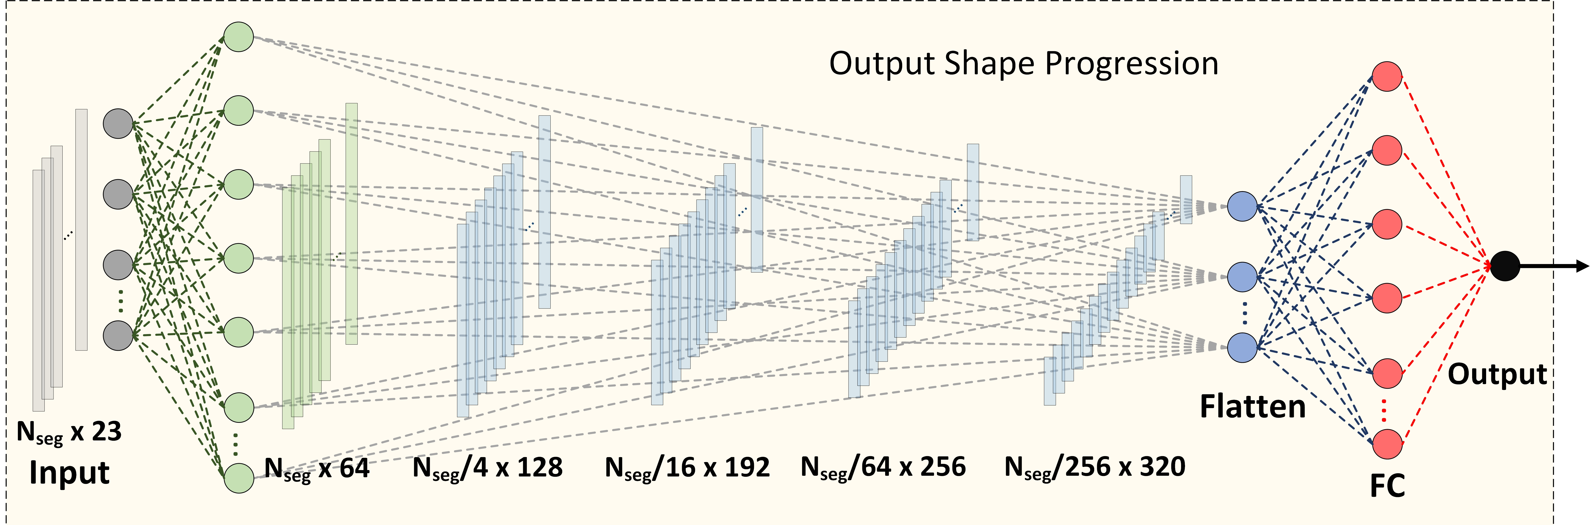
Convolution Neural Networks
Notes:
Convolution images: https://www.sciencedirect.com/topics/mathematics/convolutional-layer ConvNet Image:https://www.mdpi.com/1424-8220/21/6/2188
Bottom Right model: https://ieeexplore.ieee.org/document/9926767

Slide 26
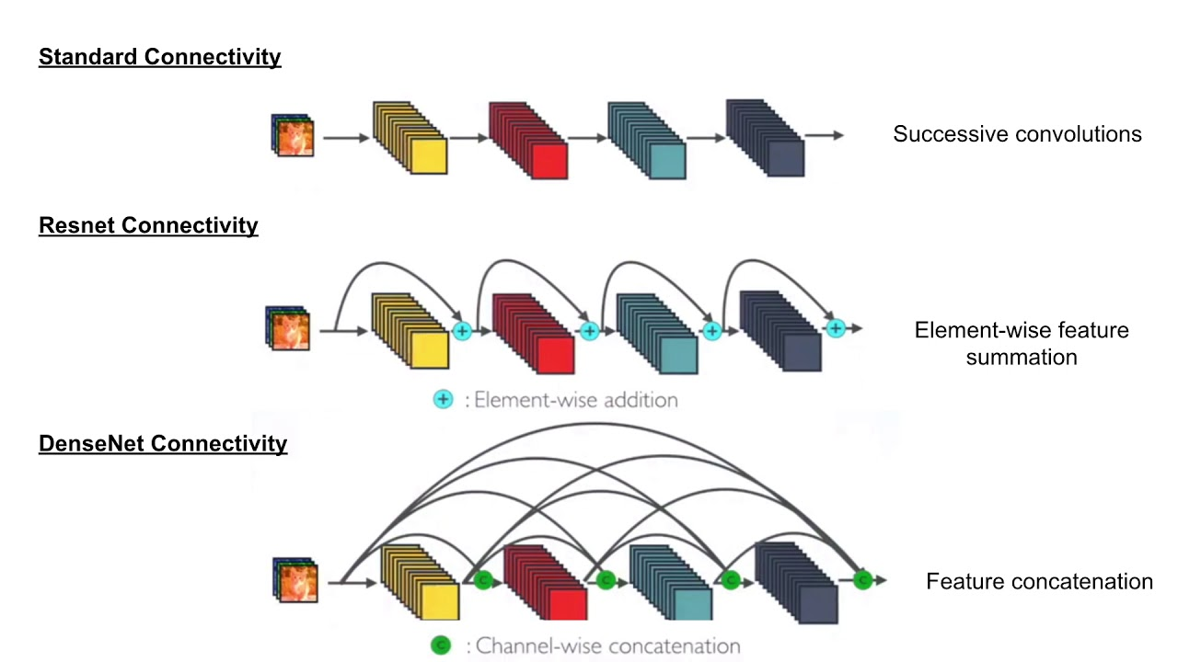
ResNets And DenseNets
Residual NNs
Dense NNs
Feature Skip connections
‘Chain’ of convolutions
May improve CNN performance
Others
AlexNet, LeNet, Unet, etc.
Notes:
https://oi.readthedocs.io/en/latest/computer_vision/cnn/densenet.html

Slide 27
Scope
AI, ML and DL
How useful is ML/AI and why now?
Regression
Classical ML
Tools and Technologies
Generative Age

Slide 28
Hands-on Activity

Slide 29
GANs, Diffusion and Tranformers
General Adversarial Nets
Generator-Discriminator
Used to generate images such as DeepFake
Diffusion
Stable vs non-stable
Transformer Architecture
Similar Structure to an Autoencoder
Both encoder-decoder parts used for training
Only the Decoder part for inference

Slide 30
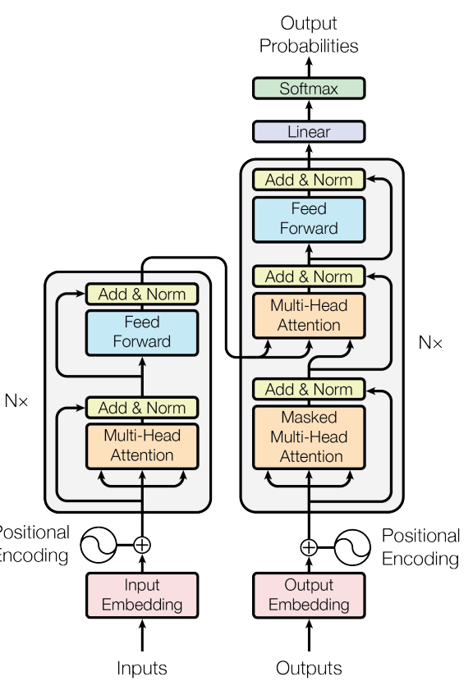
Self-Attention Layers
Attention Mechanism
N Input and Outputs
Key, Query and Values
Softmax score
Self-attention
Allows inputs to interact with each other
More attention to specific features
Multi-headed self-attention
Multiple outputs
Parallel
Notes:
https://arxiv.org/abs/1706.03762

Slide 31
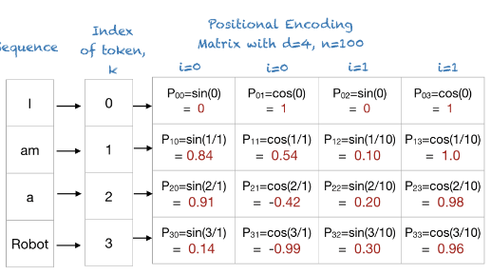
LLMs and Chatbots
General Purpose Transformer
GPT – used to make LLMs
Large dataset; large models
Able to adapt to multiple tasks
Can do “General-Purpose” AI
Provide answers to real-world questions
Notes:
https://machinelearningmastery.com/a-gentle-introduction-to-positional-encoding-in-transformer-models-part-1/

Slide 32
Latest Inventions
Llama 4 (Facebook – Huggingfface)
Gemini (Google – Colab)
GPT 4-o (OpenAI – GPT 3.5 on GitHub among other tools)
Deepseek
Vibe Coding (E.g. Cursor AI)

